Slide 1
HIV Case Finding
SIYENZA GUIDANCE

Slide 2



3 Main Testing Approaches
PITC in health facilities
Index testing
Targeted community testing (index testing and mobile testing to populations not accessing facility-based services)

Slide 3
Strategies for PICT Case Finding
Diagnostic Testing: testing of patients who present with signs or symptoms suggestive of HIV
Targeted Testing: testing of subpopulations of increased risk due to behavioral, clinical, or demographic characteristics, or a combination of these such as STI clients, alcohol abuse, or high burdened areas
Universal screening: testing all patients presenting for medical attention regardless of presenting complaint

Slide 4
Strategies for Strengthening Case Finding in Health Facilities
Coverage
(Test Everyone)
Inpatient
Screening
(Test Those Eligible)
Outpatient Departments
Index Testing
(Test Contacts of PLHIV)
HIV+ women (HTS/ART clinic)
HIV+ men (HTS/ART clinic)
Tuberculosis
Malnutrition
OVC
Well baby/ Immunization
HIV+ pregnant (ANC/PMTCT)
HIV+ children (EID/Ped. ART)
STIs
Pregnant Women

Slide 5
SIYENZA PICT Strategy
Case finding guidance for Siyenza facilities should be based on HIV testing coverage (proportion of eligible clients who have been tested for HIV):
TIER 1 facilities are facilities where HIV testing coverage is <80% for all clients, no matter the yield. These facilities should consider opt-out, universal screening.
TIER 2 facilities are facilities where HIV testing coverage is ≥80% with <5% yield. These facilities should consider targeted testing.
Note: 80% HIV testing coverage was a CDC SA programmatic decision

Slide 6
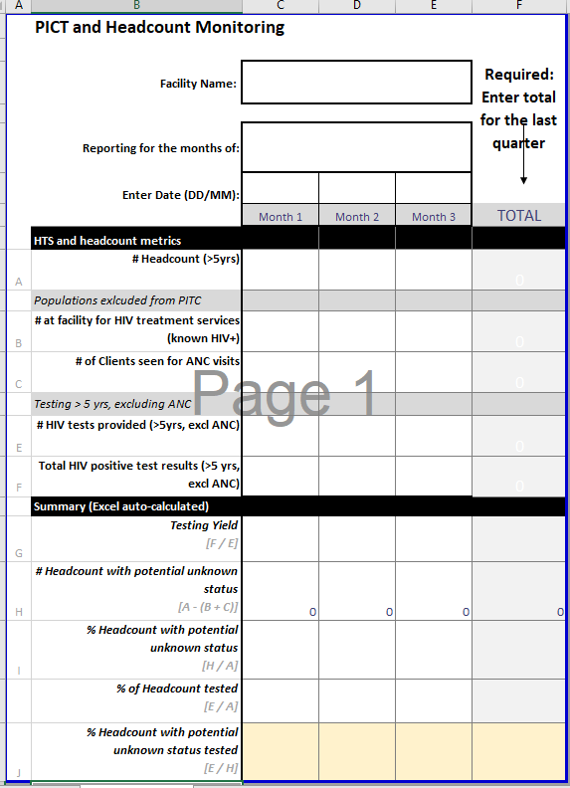
Tier 1 / Tier 2 Determination
Review current monthly headcount vs. testing coverage (Proportion of Eligible Clients) for past quarter
Use HTS metrics to calculate

Slide 7
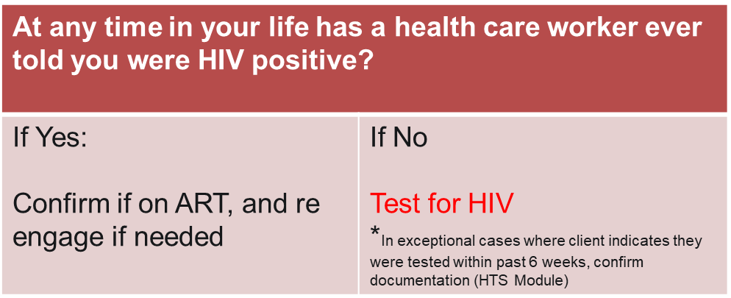
Tier 1: Facilities with a less than 80% HIV testing of proportion of the eligible headcount HIV no matter the yield: Universal Screening Approach
Screening Questions:

Slide 8
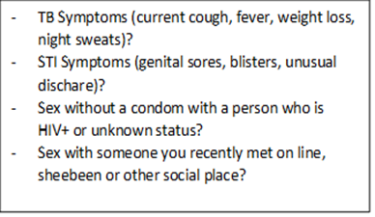
Tier 2 Facilities: (≥80% of eligible clients have been tested for HIV) but the yield is less than 5%: Targeted Testing Approach
Screening Questions:
Question | Y/N | Recommendation
At any time in your life has a health care worker ever told you were HIV positive? |  | If Yes : Confirm if on ART, and re-engage if needed If No: Go to next question
In the last year*, has a healthcare provider tested you for HIV? |  | If No: test for HIV If Yes: Go to next question
Does the client have documentation of negative prior HIV test? |  | If No: test for HIV If Yes: Screen Further for STI, TB and recent exposure
*Emphasize the change from 3 months to 12 months as this aligns with the National HTS Testing Retesting Guidelines of annual testing in absence of recent risk
If YES to any 1 of these, test for HIV

Slide 9





What Is Index Testing?
Index ≠ Household
Needle sharing partner(s)
Sex partner(s)
Biologic children
(if index=Female)
Biologic mother
(if index < 15 yr)
HIV-positive index client
Notes:
Index testing is focused on testing individuals who have known exposure to HIV.
Index testing starts with an HIV-positive index client. This client is asked to list of all of their sexual or injecting drug use partners within the past year. In addition, if the client is female, she is asked to name all of her biologic children under the age of 15 years who may have been exposed to HIV during pregnancy, childbirth, or breastfeeding.
Each listed partner and child is then contacted, informed that they have been exposed to HIV, and offered HIV testing services.
Index testing is also called partner notification services or partner services. For the purposes of this training, we will use partner index testing when we discuss testing the sex and needle using partner(s) of HIV-positive index clients and family index testing when we discuss testing the biologic children of HIV-positive index clients.

Slide 10
What are the 7 steps of index testing?
Step 1. Introduce Index Testing Services to the Index Client during pre-test session or PMTCT/ART visit
Step 2. Obtain a list of sex partners and biological children < 15 with unknown HIV status
Step 3. Conduct an intimate partner violence (IPV) risk assessment for each named partner
Step 4. Determine the preferred method of partner notification or child testing for each named partner/child
Step 5. Contact all named partners and biological children <15 with unknown status using preferred approach
Step 6. Record outcomes of partner notification and family testing
Step 7. Provide appropriate services for children and partner(s) based on HIV status

Slide 11



What is the Difference Between Passive and Active Models of Index Testing Services?
Provider Referral = A counsellor or other health care provider will call or visit your partner and inform them that they need to test for HIV.
Client Referral = You tell your partner about your HIV and encourage him or her to come to the health facility for an HIV test.
Contract Referral = You and the counsellor will work together to notify your partner. You will have 14 days to tell your partner. After which, the counsellor will contact your partner.
Dual Referral = The counsellor/provider will sit with you and your partner and support you as you tell your partner about your HIV.

Slide 12
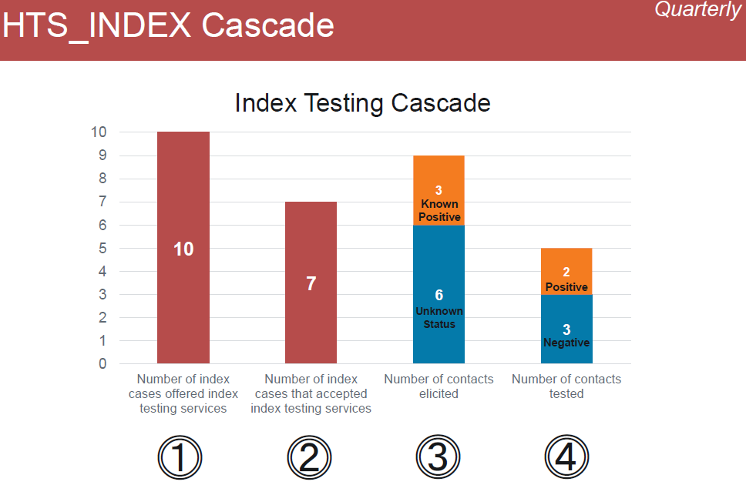
Using Cascades to Monitor the Quality of Index Testing

Slide 13

Seven Tips for Partner Elicitation
Introduce partner notification in pre-test counseling
Use appropriate language and questions to ask about partner(s) and children
Assure clients of the confidentiality of services: partners will be traced and be offered testing for the ‘Cheka Impilo’ National Wellness Campaign
There is no need for client to disclose their HIV status if they don’t feel safe or comfortable, partners can be traced and offered a test anonymously through provider notification.
Use humor and slang to probe for additional partners and make clients feel comfortable with you
Use brief motivational interviewing to create rapport with clients
Provide opportunities for supportive supervision and mentoring

Slide 14
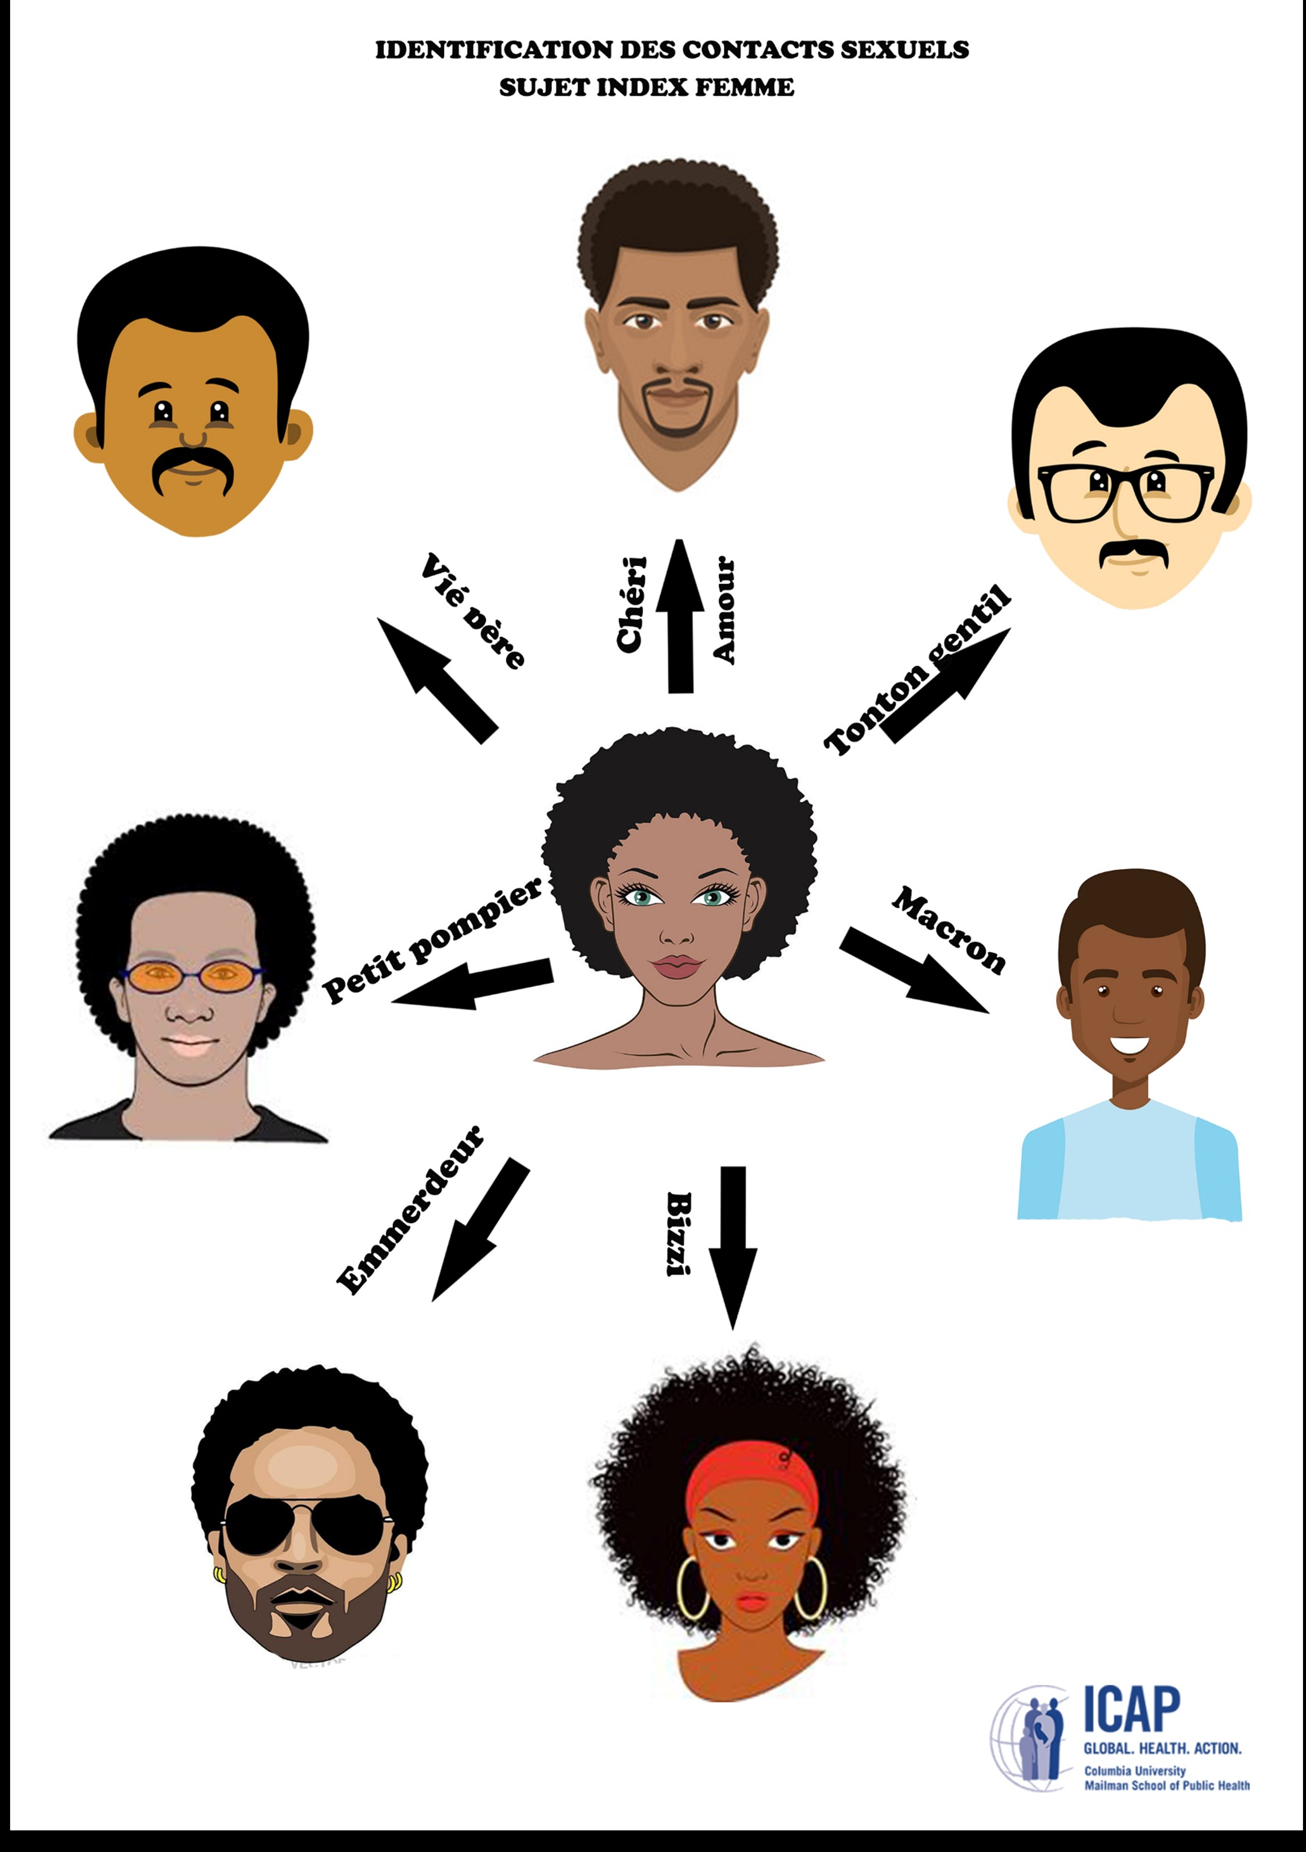
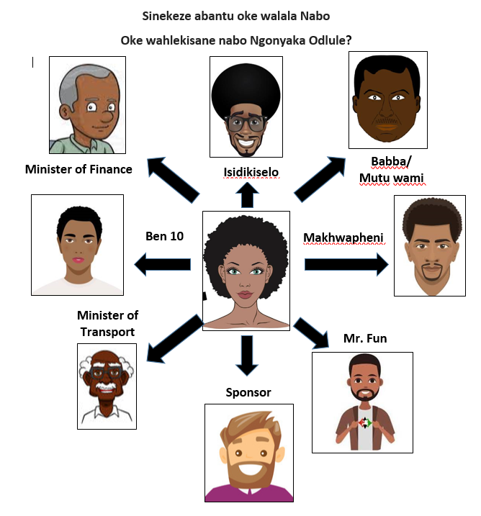
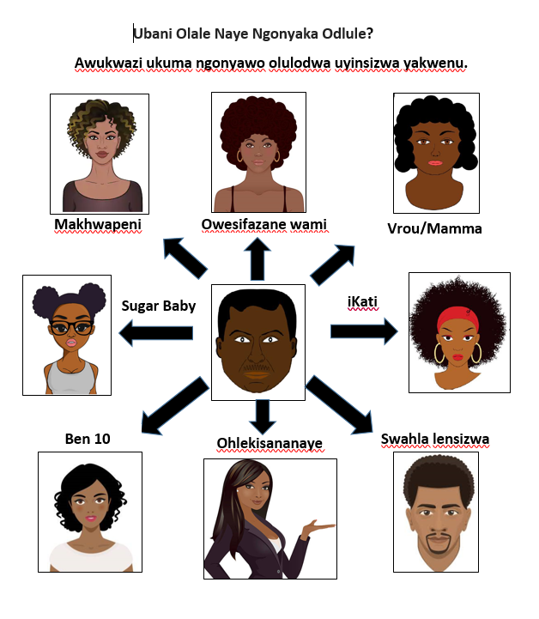
Use Humor and Appropriate Slang to Probe and Make the Client Feel Comfortable

Slide 15
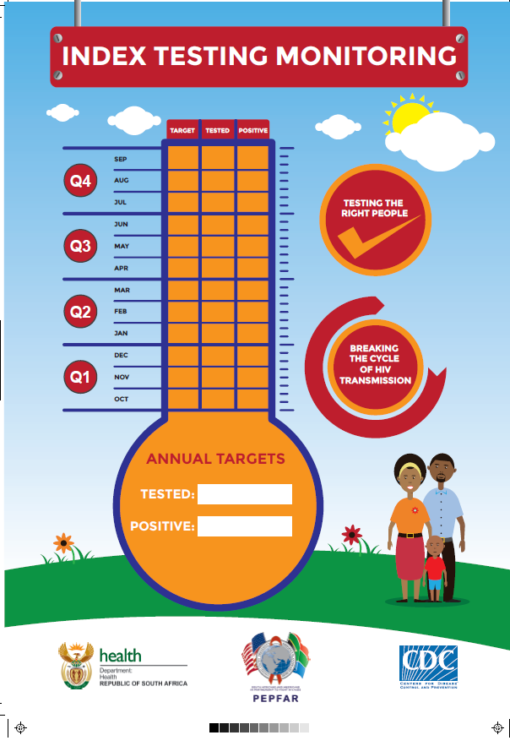
Tools Available to Support Index Testing
Job Aids on 7 Steps, Types of Notifications, etc
Counselor Scripts
SOP on index testing along with training slides
ICT register
Site level monitoring tool
GBV and adverse event monitoring tool

Slide 16
Other best practices for index testing
EAC = Index
Elicit the contacts of the newly identified positive client to exhaust the sexual network
Make use of the outreach teams and other community-based partners
Trust but verify for “known” positives and ART clients

